Slide 1
UNIT-2

Slide 2
Relational Model
E.F. Codd proposed the relational Model in 1970 to model data in the form of relations (tables).
It is widely used model for many RDBMS products like IBM's DB2 , Oracle, Sybase, Microsoft's SQL Server etc.

Slide 3
Relational Model
A relational database is a collection of relations with distinct names, where each relation is a table of rows and columns.
A Relation consists of a relational schema and a Relational instance.

Slide 4
Relational Model
Relational Schema describes the structure of the relation. It specifies the relation name, the names of fields(columns or attributes), and the domain of each field.
Example:
Emp( eid: integer, ename: string, age: integer , salary: real )
Dept(did: integer, dname: string, managerid: integer)

Slide 5
Relational Model
Relation instance is a set of tuples or records, where each tuple has the same number of fields as the relation schema.
It is the collection of records present in the relation at a given time.

Slide 6
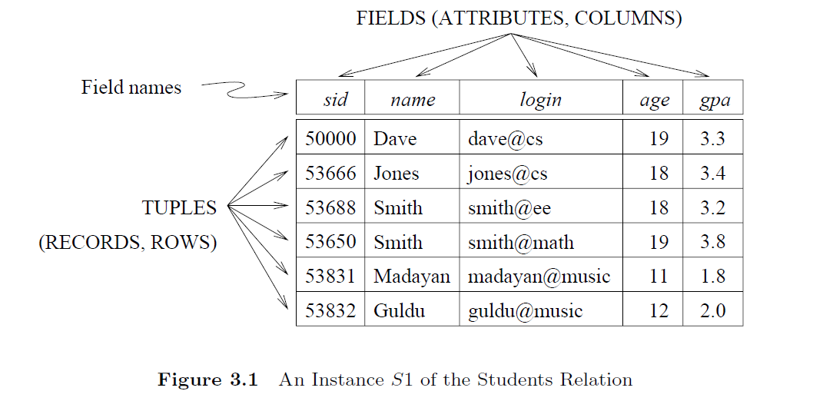
Instance of Students Relation

Slide 7
Relational Model Concepts
Relation : Two-dimensional table used to store a collection of data.
Tuple : Each row in the relation is known as a tuple.
Attribute/Field : Column of the relation, depicting properties of the relation.
Domain : Set of values that a column can take.

Slide 8
Relational Model Concepts
Degree: The number of attributes (columns) in the relation is known as the degree or arity of the relation. The STUDENT relation defined above has degree 5.
Cardinality : It is the total number of tuples (rows) present in the relation. The STUDENT relation defined above has cardinality 6.

Slide 9
SQL Query Language
A Query is a question about the data in DB, and the answer consists of a new relation containing the result.
For example, we want to find all students younger than 18 .
we can write:
SELECT *
FROM Students S
WHERE S.age = 18 ;

Slide 10
SQL Query Language
A query language is a specialized language for writing queries.
SQL is the most popular commercial query language for a relational DBMS.
It is developed by IBM (system R) in the 1970s.

Slide 11
Creating Relations Using SQL
SQL uses the word “table” to denote relation.
Data Definition Language (DDL) is a subset of SQL that supports the creation, deletion, and modification of tables(relations).
DDL commands:
Create table command
Alter table command
Truncate table command
Drop table command
Rename

Slide 12
Creating Relations Using SQL
The CREATE TABLE statement is used to create a new table in a database.
CREATE TABLE table_name ( column1 datatype, column2 datatype, column3 datatype, .... );

Slide 13
Creating Relations Using SQL
The CREATE TABLE statement is used to create a new table in a database.
EX: CREATE TABLE Students ( sid INTEGER
name CHAR(30),
age NUMBER,
gpa NUMBER );

Slide 14
Creating Relations Using SQL
Example:
CREATE TABLE Enrolled(sid CHAR(20),
cid CHAR(20),
grade CHAR(2))

Slide 15
Altering Relations
ALTER TABLE statement used to add, delete, modify columns in a table.
1. ADD a column:
SYNTAX: ALTER TABLE <table name>
ADD COLUMN colname DATATYPE (SIZE);
Example: ALTER TABLE student ADD COLUMN email VARCHAR2(20) ;

Slide 16
Altering Relations
To delete a column:
ALTER TABLE <table name>
DROP COLUMN <column name>;
Example: ALTER TABLE student DROP COLUMN
gpa;

Slide 17
Altering Relations
Modify a column:
ALTER TABLE <table name>
MODIFY <colname> <NEW DATATYPE>;
Example : ALTER TABLE student
MODIFY name char(20);

Slide 18
Destroying Relations
DESTROY A TABLE
Drop command is used to remove an existing table permanently from database.
DROP TABLE <tablename>;
Example: DROP TABLE student;

Slide 19
Adding Tuples into Relation
SQL INSERT INTO Statement is used to add new rows of data into a table in the database.
Syntax: INSERT INTO TABLE_NAME
(column1, column2, column3,..., columnN)
VALUES (value1, value2, value3, ..., valueN);
Example: INSERT INTO Students (sid, name, age, gpa) VALUES (53688, `Smith', 18, 3.2);

Slide 20
Deleting Tuples
DELETE Statement is used to delete the records from an existing table. In order to filter the records to be deleted (or delete particular records), we need to use the WHERE clause along with the DELETE statement.
If you execute DELETE statement without a WHERE clause, it will delete all the records from the table.

Slide 21
Deleting Tuples
Syntax: DELETE FROM table_name
WHERE [condition];
Example:
DELETE FROM Students S
WHERE S.name = `Smith‘;

Slide 22
INTEGRITY CONSTRAINTS
An integrity constraint (IC) is a condition that is specified on a database schema, to restrict the data being stored in an instance of the database.
If a database instance satisfies all the integrity constraints specified on the database schema, it is a legal instance.

Slide 23
INTEGRITY CONSTRAINTS
Constraints are the rules applied to columns or the complete table to prevent the type of data that can go into a table.
When you try to perform any INSERT, UPDATE, or DELETE operation on the table, RDBMS will check whether that data violates any existing constraints and if there is any violation between the defined constraint and the data action, it aborts the operation and returns an error.

Slide 24
INTEGRITY CONSTRAINTS
Integrity constraints are specified by the DBA or end user when defining a database schema, he or she specifies the ICs that must hold on this database.
Many kinds of integrity constraints can be specified in the relational model.
Domain constraints
DEFAULT, NOT NULL, CHECK
Key Constraints – Primary key
Referential Integrity constraints - Foreign Key

Slide 25
Key Constraints or key
A key is an attribute or set of attributes in a relation whose values uniquely identifies a tuple in that relation.
Every relation is guaranteed to have a key.
There are different keys for a relation.
Super key
Candidate Key
Primary Key
Alternate Key
Composite Key

Slide 26
Key Constraints or key
Super key
A super key can be an attribute or group of attributes in a table that can identify each row in that table uniquely.
A table contains many no of super keys.
Super key can also be viewed as collection of all those keys that identify a tuple uniquely.

Slide 27
Student Relation
Rollno | Sname | ABC_Id | contact
101 | Raj | 534125 | 12345
102 | Kumar | 534128 | 34567
103 | Raj | 534123 | 34567
104 | Sai | 534127 | 78956

Slide 28
Super keys for Student Relation
For the student table, we have the following set of the super keys:
{ {Rollno} ,
{ABC_Id},
{Rollno, ABC_Id} , {Rollno, Sname},
{Rollno, Sname, ABC_Id} , ……………..
{Rollno, Sname, ABC_Id, contact}
}

Slide 29
Key Constraints or key
Candidate Key
A candidate key is a minimal subset of attributes that uniquely identifies a tuple (or) smallest possible super key.
In order to select the candidate keys, we need to look at the super key set.
For the student table, we have the following candidate keys:
{Rollno}
{ABC_Id}

Slide 30
Key Constraints or key
Primary Key:
A primary key is a candidate key that is chosen to be the official unique identifier for a row in the table.
A table can have multiple candidate keys, but can only have one primary key.
Out of all the available candidate keys, a database designer can declare only one to be primary key.
Example for student relation : Rollno

Slide 31


Slide 32
Alternate Key
Alternate Key
The candidate key other than the primary key is called an alternate key.
All the keys which are not primary keys are called alternate keys.
It is a secondary key.
It contains two or more fields to identify two or more records.
These values are repeated.
Eg:- SNAME, and ADDRESS is Alternate keys

Slide 33
Composite key
Sometimes, a table might not have a single column/attribute that uniquely identifies all the records of a table. To uniquely identify rows of a table, a combination of two or more columns/attributes can be used. It still can give duplicate values in rare cases. So, we need to find the optimal set of attributes that can uniquely identify rows in a table.
It acts as a primary key if there is no primary key in a table
Two or more attributes are used together to make a composite key.
Different combinations of attributes may give different accuracy in terms of identifying the rows uniquely.

Slide 34
Defining Primary Key using SQL
CREATE TABLE Students ( Rollno NUMBER,
Sname CHAR(30),
ABC_Id NUMBER,
CONSTRAINT StudentsKey PRIMARY KEY (Rollno) );
This statement defines Rollno as the primary key.
we can name a constraint by preceding it with “CONSTRAINT constraint-name”.
If the constraint is violated, the constraint name is returned and can be used to identify the error.

Slide 35
Foreign Key Constraints
Sometimes the information stored in a relation is linked to the information stored in another relation.
If one of the relations is modified, the other must be checked and modified, to keep the data consistent.
An IC involving two relations is a foreign key constraint.

Slide 36
Foreign Key Constraints
A FOREIGN KEY is a field (or collection of fields) in one table, that refers to the PRIMARY KEY in another table.
The table with the foreign key is called the child table, and the table with the primary key is called the referenced or parent table.
A foreign key is used to establish a link between two tables.
FOREIGN KEY constraint prevents invalid data from being inserted into the foreign key column, because it has to be one of the values contained in the parent table.

Slide 37
Foreign Key Constraints
Suppose there are two relations
1. Students( sid: integer, name: string, login: string,
age: integer, gpa: real )
2. Enrolled(sid: integer, cid: string, grade: string)

Slide 38
Foreign Key Constraints
To ensure that only bonafide students can enroll in courses, any value that appears in the ‘ sid’ column of the Enrolled relation should also appear in the ‘sid’ column of some tuple in the Students relation.
The “sid” column of Enrolled relation is called a foreign key and refers to Students.
The foreign key must match the primary key of the referenced relation (Students), i.e., it must have the same number of columns and compatible data types.

Slide 39
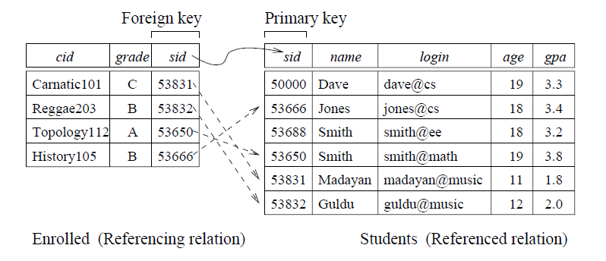
Foreign Key Constraints

Slide 40
Defining Foreign Key using SQL
CREATE TABLE Enrolled ( sid NUMBER,
cid CHAR(20),
grade CHAR(10),
PRIMARY KEY (sid, cid),
FOREIGN KEY (sid) REFERENCES Students(sid) );

Slide 41
ENFORCING INTEGRITY CONSTRAINTS
ICs are specified when a relation is created and enforced when a relation is modified.
If an insert, delete, or update command causes a violation, then data operation is rejected.
Potential IC violation is generally checked at the end of each SQL statement execution.
Consider the student relation again.

Slide 42
Student Relation
Rollno | Sname | ABC_Id | contact
101 | Raj | 534125 | 12345
102 | Kumar | 534128 | 34567
103 | Raj | 534123 | 34567
104 | Sai | 534127 | 78956

Slide 43
ENFORCING INTEGRITY CONSTRAINTS(primary key)
The following insertion violates the primary key constraint on Rollno because there is already a tuple with the Rollno 103, and it will be rejected by the DBMS:
INSERT INTO Students
(Rollno, Sname, ABC_Id, contact)
VALUES (103, ’satya', `345123', 123333);

Slide 44
ENFORCING INTEGRITY CONSTRAINTS(primary key)
The following insertion violates the primary key constraint on Rollno that the primary key cannot contain null.
INSERT INTO Students
(Rollno, Sname, ABC_Id, contact)
VALUES (null, ’satya', `345123', 123333);

Slide 45
ENFORCING INTEGRITY CONSTRAINTS(domain)
A similar problem arises whenever we try to insert a tuple with a value in a field that is not in its domain.
i.e., whenever violate a domain constraint.
Example: Rollno column cannot accept string values
INSERT INTO Students
(Rollno, Sname, ABC_Id, contact)
VALUES (xyz, ’satya', `345123', 123333);

Slide 46
ENFORCING INTEGRITY CONSTRAINTS
Deletion does not cause a violation of domain, primary key constraints.
Example:
Delete from student S where S.Rollno=101;

Slide 47
ENFORCING INTEGRITY CONSTRAINTS(primary Key)
The following update command violates the primary key constraint because there is already a tuple with Rollno 104. Hence it is rejected.
UPDATE Students S
SET S.Rollno = 104
WHERE S.Rollno = 101

Slide 48
ENFORCING INTEGRITY CONSTRAINTS(Foreign Key)
The impact of foreign key constraints is more complex.
Consider the two tables
Student(sid integer , name string, Age integer)
Enrolled(sid integer, cid string, grade string)
The “sid” column of Enrolled relation is a foreign key and refers to Students ‘sid’ column which is primary key.

Slide 49
Student Relation
Sid | name | Age
101 | Raj | 17
102 | Kumar | 18
103 | Raj | 18
104 | Sai | 19

Slide 50
Enrolled Relation
Sid | Cid | Grade
101 | dbms | A
102 | java | A
103 | C | B

Slide 51
ENFORCING INTEGRITY CONSTRAINTS(Foreign Key)
Deletion of Enrolled tuples do not violate referential integrity, but insertions of Enrolled tuples can violate Foreign Key.
The following insertion is rejected because there is
no student with sid 100 in student table.
Ex: INSERT INTO Enrolled (sid, cid,grade)
VALUES (100, `DBMS', ‘A’);

Slide 52
ENFORCING INTEGRITY CONSTRAINTS(Foreign Key)
Insertion of Student tuples do not violate referential integrity but deletion of student tuples can violate Foreign Key.
The following deletion is rejected as a child record exists with the value “101” in enrolled table.
Delete from student where sid=101;

Slide 53
ENFORCING INTEGRITY CONSTRAINTS(Foreign Key)
There are several alternative ways to handle foreign key violations.
1 . If an Enrolled row is inserted, with a sid column value that does not appear in any row of the Students table?
In this case the INSERT command is simply rejected.

Slide 54
ENFORCING INTEGRITY CONSTRAINTS(Foreign Key)
2. What happens if a Students row is deleted?
The options available are:
Delete all Enrolled rows that refer to the deleted Students row. ( on delete cascade)
Disallow the deletion of the Students row if an Enrolled row refers to it.
For every Enrolled row that refers to Students row, set the sid column to null. (on delete set null)

Slide 55
ENFORCING INTEGRITY CONSTRAINTS(Foreign Key)
Option A: Delete all Enrolled rows that refer to the deleted Students row. ( on delete cascade)
Create table ENROLLED (sid number,
cid char(10),
grade char(10),
Foreign key(sid) references student(sid)
on delete cascade);

Slide 56
ENFORCING INTEGRITY CONSTRAINTS(Foreign Key)
Option C: set all Enrolled rows that refer to the deleted Students row to NULL
(ON DELETE SET NULL)
Create table ENROLLED (sid number,
cid char(10),
grade char(10),
Foreign key(sid) references student(sid)
on delete set NULL);

Slide 57
QUERYING RELATIONAL DATA
In DBMS, a query is a request for data or information from a database.
Queries are used to retrieve, update, or delete data stored in a database.
They are written in a specific language called Structured Query Language (SQL).
SQL allows users to interact with databases by performing various operations on the data.

Slide 58
Student Relation
Sid | name | Age
101 | Raj | 17
102 | Kumar | 18
103 | Raj | 18
104 | Sai | 19

Slide 59
Enrolled Relation
Sid | Cid | Grade
101 | dbms | A
102 | java | A
103 | C | B

Slide 60
QUERYING RELATIONAL DATA
SELECT Query:
Used to retrieve data from one or more tables.
Syntax: SELECT column1, column2, ...
FROM table_name WHERE condition;
Example: Display details of students who age is lesser than 18.
SELECT * FROM Students S
WHERE S.age < 18

Slide 61
QUERYING RELATIONAL DATA
SELECT Query:
Example: Display the names of all students who obtained A grade and the id of the course in which they got an A.
SELECT S.name, E.cid
FROM Students S, Enrolled E
WHERE S.sid = E.sid AND E.grade = `A'

Slide 62
Views
A view is a virtual table whose rows are not stored in database.
It has no data of its own, but derives data from other tables on which it is based. These tables are called base tables.
Base Table can be actual table or might be a view also.
It only has a definition, SELECT statement is used to define views.

Slide 63
Views
A view can also be called as stored query.
All operations (insert, update, delete) performed on a view affect the base table of the view.
Views can be used to query, insert into, update, delete data just like a standard table .

Slide 64
Types of views
Simple view
A view created based on a single table with out using Aggregate functions , group by ,order by clauses, subquery.
Complex view.
A view created based on multiple tables or based on a single table using Aggregate functions, group by , order by clauses, Subquery.

Slide 65
Creation of views
We can create View using CREATE VIEW statement.
A View can be created from a single table or multiple tables.
Syntax:
CREATE OR REPLACE VIEW view_name AS
SELECT column1, column2..... ……
FROM table_name
[WHERE condition] ;

Slide 66
Creating Simple view
Example1(Selecting few columns)
CREATE OR REPLACE VIEW V1_EMP AS
SELECT ENO, ENAME,DEPTNO
FROM EMP ;
Example 2: (Selecting all columns in table)
CREATE OR REPLACE VIEW V1_EMP AS
SELECT * FROM EMP ;

Slide 67
Creating Simple view
Example3 :
CREATE OR REPLACE VIEW V1_EMP AS
SELECT ENO, ENAME,DEPTNO
FROM EMP WHERE DEPTNO=10;
We can use DESC command on a view to know its structure .( fields in view).
Example:
DESC V1_EMP;

Slide 68
Using Views in Queries
SQL allows on Simple view to perform selection (read operation) and DML (modify)operations.
we can Query a view using select statement just like a standard table.
Example:
Select eno, ename, deptno from V1_emp;
Select * from V1_emp where deptn0=10;

Slide 69
Using Views in Queries
Insertion through View
The following statement inserts a new row into “emp” table using V1_emp view.
SQL>INSERT INTO V1_EMP VALUES (103 ,’raghu’,20);
Update through view
SQL> UPDATE V1_EMP SET DEPTNO=20 WHERE ENO=101;
Deletion through view
SQL> DELETE FROM V1_EMP WHERE ENO=101;

Slide 70
Updatable view
An updatable view allows users to perform various data manipulation operations, such as inserting, updating, and deleting records, as if they were interacting with a base table.
However, not all views are automatically updatable. There are certain conditions that a view must meet in order to be updatable. These conditions are defined by the DBMS.

Slide 71
EMP TABLE
ENO | ENAME | HIREDATE | SALARY | DEPTNO | JOB
101 | JOHN | 02-JUN-2001 | 2500 | 10 | CLERK
102 | SMITH | 06-AUG-2007 | 3000 | 20 | MANAGER
103 | ROSE | 31-JUL-2008 | 4000 | 10 | MANAGER
104 | HENRY | 04-SEP-2009 | 1500 | 20 | CLERK
105 | JAMES | 05-JUN-2008 | 2000 | 30 | CLERK

Slide 72
Create View - WITH READ ONLY CLAUSE
We can create a view as read only by adding WITH READ ONLY clause to the view.
SQL> CREATE VIEW V2_EMP AS
SELECT * FROM EMP WITH READ ONLY;
If we perform update operation on above view ,it will be terminated.
SQL> UPDATE V2_EMP SET SAL=1000 WHERE
ENO=103; OUTPUT: ERROR

Slide 73
VIEW V2_EMP
ENO | ENAME | HIREDATE | SALARY | DEPTNO | JOB
101 | JOHN | 02-JUN-2001 | 2500 | 10 | CLERK
102 | SMITH | 06-AUG-2007 | 3000 | 20 | MANAGER
103 | ROSE | 31-JUL-2008 | 4000 | 10 | MANAGER
104 | HENRY | 04-SEP-2009 | 1500 | 20 | CLERK
105 | JAMES | 05-JUN-2008 | 2000 | 30 | CLERK

Slide 74
Create View - WITH CHECK OPTION CLAUSE
WITH CHECK OPTION clause can be given for an updatable view to prevent insertion of rows for which the WHERE condition in “select stmt ”is not true.
It also prevents updation of rows which causes the WHERE condition to be not true .
In other words, it prevents visible rows from being updated to nonvisible rows.

Slide 75
EMP TABLE
ENO | ENAME | HIREDATE | SALARY | DEPTNO | JOB
101 | JOHN | 02-JUN-2001 | 2500 | 10 | CLERK
102 | SMITH | 06-AUG-2007 | 3000 | 20 | MANAGER
103 | ROSE | 31-JUL-2008 | 4000 | 10 | MANAGER
104 | HENRY | 04-SEP-2009 | 1500 | 20 | CLERK
105 | JAMES | 05-JUN-2008 | 2000 | 30 | CLERK

Slide 76
Create View - WITH CHECK OPTION CLAUSE
Example :
SQL> CREATE VIEW V3_EMP AS
SELECT ENO,ENAME, SAL, DEPTNO
FROM EMP WHERE DEPTNO=10
WITH CHECK OPTION;

Slide 77
View V3_EMP
ENO | ENAME | SALARY | DEPTNO
101 | JOHN | 2500 | 10
103 | ROSE | 4000 | 10

Slide 78
UPDATION ON VIEW WITH CHECK
SQL>UPDATE V3_EMP SET DEPTNO=20
WHERE ENO=101;
ERROR: CHECK CLAUSE VIOLATED

Slide 79
Complex view
A view created based on multiple tables or based on a single table using Aggregate functions, group by , order by clauses, Subquery.
Example:
CREATE VIEW V4_EMP AS
SELECT DEPTNO,SUM(SAL) AS TOTALSAL
FROM EMP
GROUP BY DEPTNO;

Slide 80
VIEW V4_EMP
DEPTNO | TOTALSAL
10 | 6500
20 | 4500
30 | 2000

Slide 81
Complex view – DML Operations
SQL>DELETE FROM V4_EMP WHERE DEPTNO=10;
OUTPUT: NOT ALLOWED
SQL>INSERT INTO V4_EMP VALUES(50,24000);
OUTPUT: NOT ALLOWED
SQL>UPDATE V4_EMP SET DEPTNO=20
WHERE DEPTNO = 30;
OUTPUT: NOT ALLOWED

Slide 82
Complex view - Example
CREATE VIEW V5_EMP AS
SELECT * FROM EMP JOIN DEPT
USING(DEPTNO);

Slide 83
Renaming and Drop view
Rename
SQL>RENAME V_EMP TO V7-EMP;
Drop view
SQL>DROP VIEW V7_EMP;

